Slide 1

Machine Learning meets Embedded Development
The Qt Company
Ekkono
09 June 2021
Notes:
Target audience
Knows nothing or little about Qt
Technical and/or C-level, we should accommodate both
Decision makers
Intention of presentation
Overall: Pitch the Qt values from different perspectives to different target groups
How:
High-level explanation of what Qt is
Challenges and how Qt can solve these
Show how the design-develop-deploy workflow is supported by Qt
Compare with competition and point at Qt’s strengths
Customer success stories

Slide 2
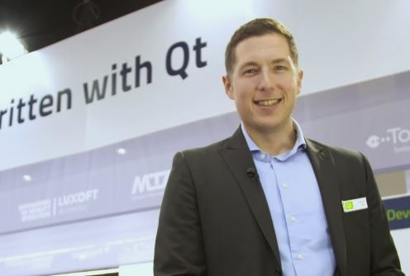


Machine Learning meets Embedded Development
speakers
Michele Rossi
Business Development, Qt Venture
The Qt Company
Simon Hedström
Machine Learning Engineer
Ekkono Solutions
Amit Nainawat
Pre-Sales Engineer
The Qt Company

Slide 3




A growing complexity in the embedded development market
Machine Learning meets Embedded Development
UI / UX Designer
Product managers / Management
Qt & Ekkono
Machine Learning / Data Scientist Expert
Developers
Faster GoToMarket:
  as a company I want to validate and integrate the optimal model faster in my Qt application
Scalability:
  As a company I want to have the freedom to port and reuse my application output across all different use cases I have
CAPEX & OPEX costs:
  Investing in a DIY toolchain is a huge investment in terms of initial effor and maintenance burden
  As a company I want to reduce as much as possible my Bill of Material, and limit the interaction between a device and cloud platform
Industry
Pain Points

Slide 4


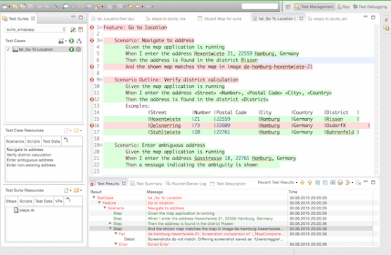



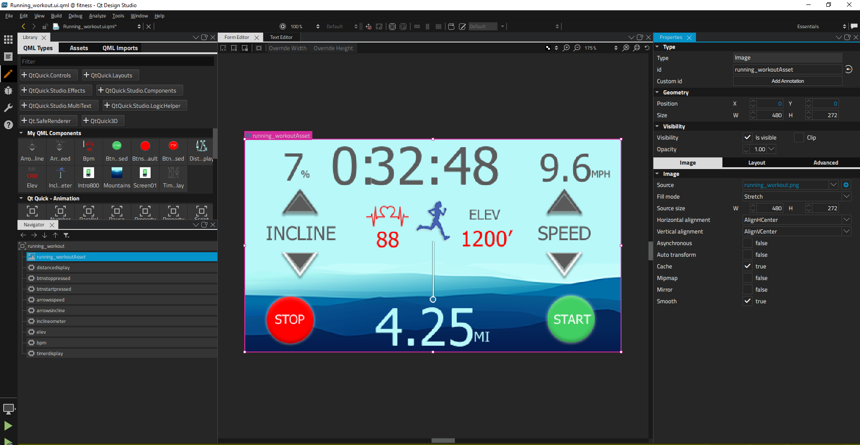
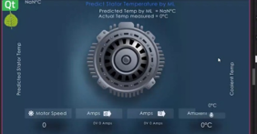
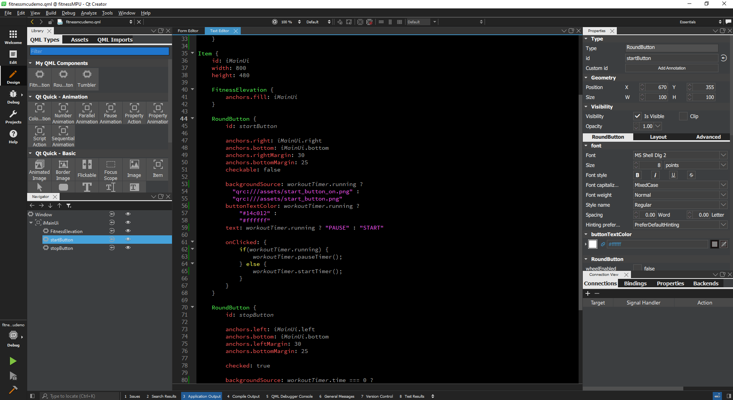

A unified toolchain to create and maintain your application
DESIGN – MODEL – TEST - DEPLOY
Qt Design Studio
Test
One framework for all deployment
UI Asset
Desktop
Mobile
MCU
MPU
WEB
ML Model
QML and Model
Deploy
Qt Creator
Notes:
Design tool bridges: Import your UI designs from Photoshop and Sketch to 2D Qt QML
Scene editors: Fine-tune your designs to pixel-perfection
Side-by-side visual and code editor: Modify your designs visually or with QML - Qt's easy to use declarative language
3D editor: is now much improved from 1.4.
Visual flow editor: Preview of what we’re working on, demo to follow later on. Basically allows fast prototyping inside the Qt Design Studio.
Dynamic layouts: Adapt your UI to any screen
Components: Qt turns your assets into QML components that can be reused in different projects. Qt has also Ready-made and customizable buttons, switches, dials
Timeline-based animations: With fully customizable easing curves makes breathing life into your designs with animations simple
Built-in and customizable visual effects: Fancy up your graphic designs
Live on-device UI previews: See how your changes affect the UI directly on your target device
Now I am going to show you the Qt toolchain from design to deploy, it is called designer developer workflow.
Qt have developed a plugins for Abobe photoshop and Apple Sketch, this plugin is called Qt bridge. By using Qt bridge an Artwork from photoshop or from Sketch can be imported into the Qt design studio, during the import process Qt design studio generates the reusable QML code.
Later designers can work on this auto generated QML code and finally add the user experience; graphical part is validated by the designer as they visualize the final GUI in Qt design studio without deploying on the real HW target.
Once visual validation of UI/UX is done by UX engineers, code is passed to the developer. Developer uses the Qt Creator where they 0work on the backend connection, write C++ logic and integration code for the GUI. Qt Creator is tool for the software development life cycle, ie you can design, develop, debug, optimize and finally deploy your application on target HW like desktop, MCU, embedded targets, etc..

Slide 5
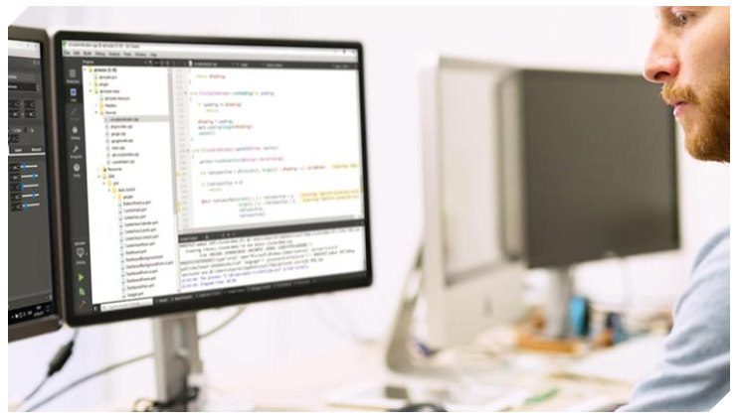
Closing the gap between data scientists, and embedded stakeholders
The problem we are looking to solve
Training
Model exchange
Input data
Iteration
Optimization
One framework for all deployment
Desktop
Mobile
WEB
MCU
MPU
How we help companies:
To deploy and integrate ML application in productions: we support you on optimizing the model you need
The IP is yours; we enable you to deploy your knowledge in your application
Deployment cross platform: desktop, mobile, edge
By using incremental learning, we enable Offline training - no need to use cloud infrastructure to train models, saving connectivity costs
Reducing the Bill of Material implementing the concept of Virtual Sensors

Slide 6

How to try Qt & Ekkono in your commercial application
Booking an appointment with us
Available for commercial trials or commercial customers only
Reaching out your local Qt contact
Reaching out your local Ekkono contact
New to Qt? Write to us: https://www.qt.io/contact-us/sales-contact-request

Slide 7


FROM CONNECTED TO SMART

Slide 8


Ekkono is a
Swedish Software Company
who does Edge Machine Learning

Slide 9
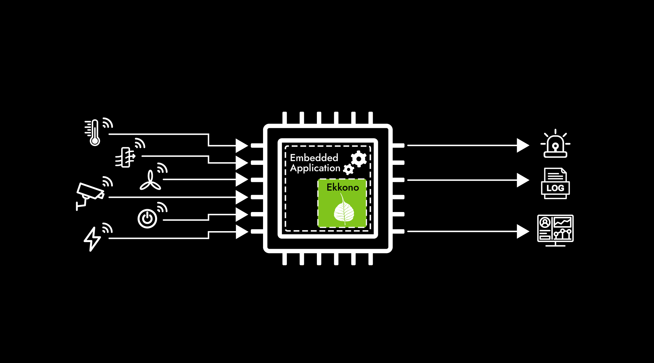
Ekkono’s Edge
Machine Learning
Exactly, we do machine learning and not just inference
at the edge, which means that we can learn individual use
and super-local conditions. We even do this on really small devices with sensor size micro controller units.
Sensor layer
Embedded layer
Communication
& Control Layer

Slide 10

Software
Development
Kit
A comprehensive toolbox to support implementation and integration
Learning on streaming sensor data
Incremental learning at the edge, onboard devices
Supports execution
of pre-trained models
Ekkono’s SDK is a comprehensive toolbox to support implementation and integration, 100% software and totally platform agnostic. The core is a C++ library.
The product is designed for developers and the API
offers bindings to C# and Python.
Limited data science experience required
to deploy advanced edge machine learning
Supports ML techniques, including decision trees, random forest, and neural networks

Slide 11
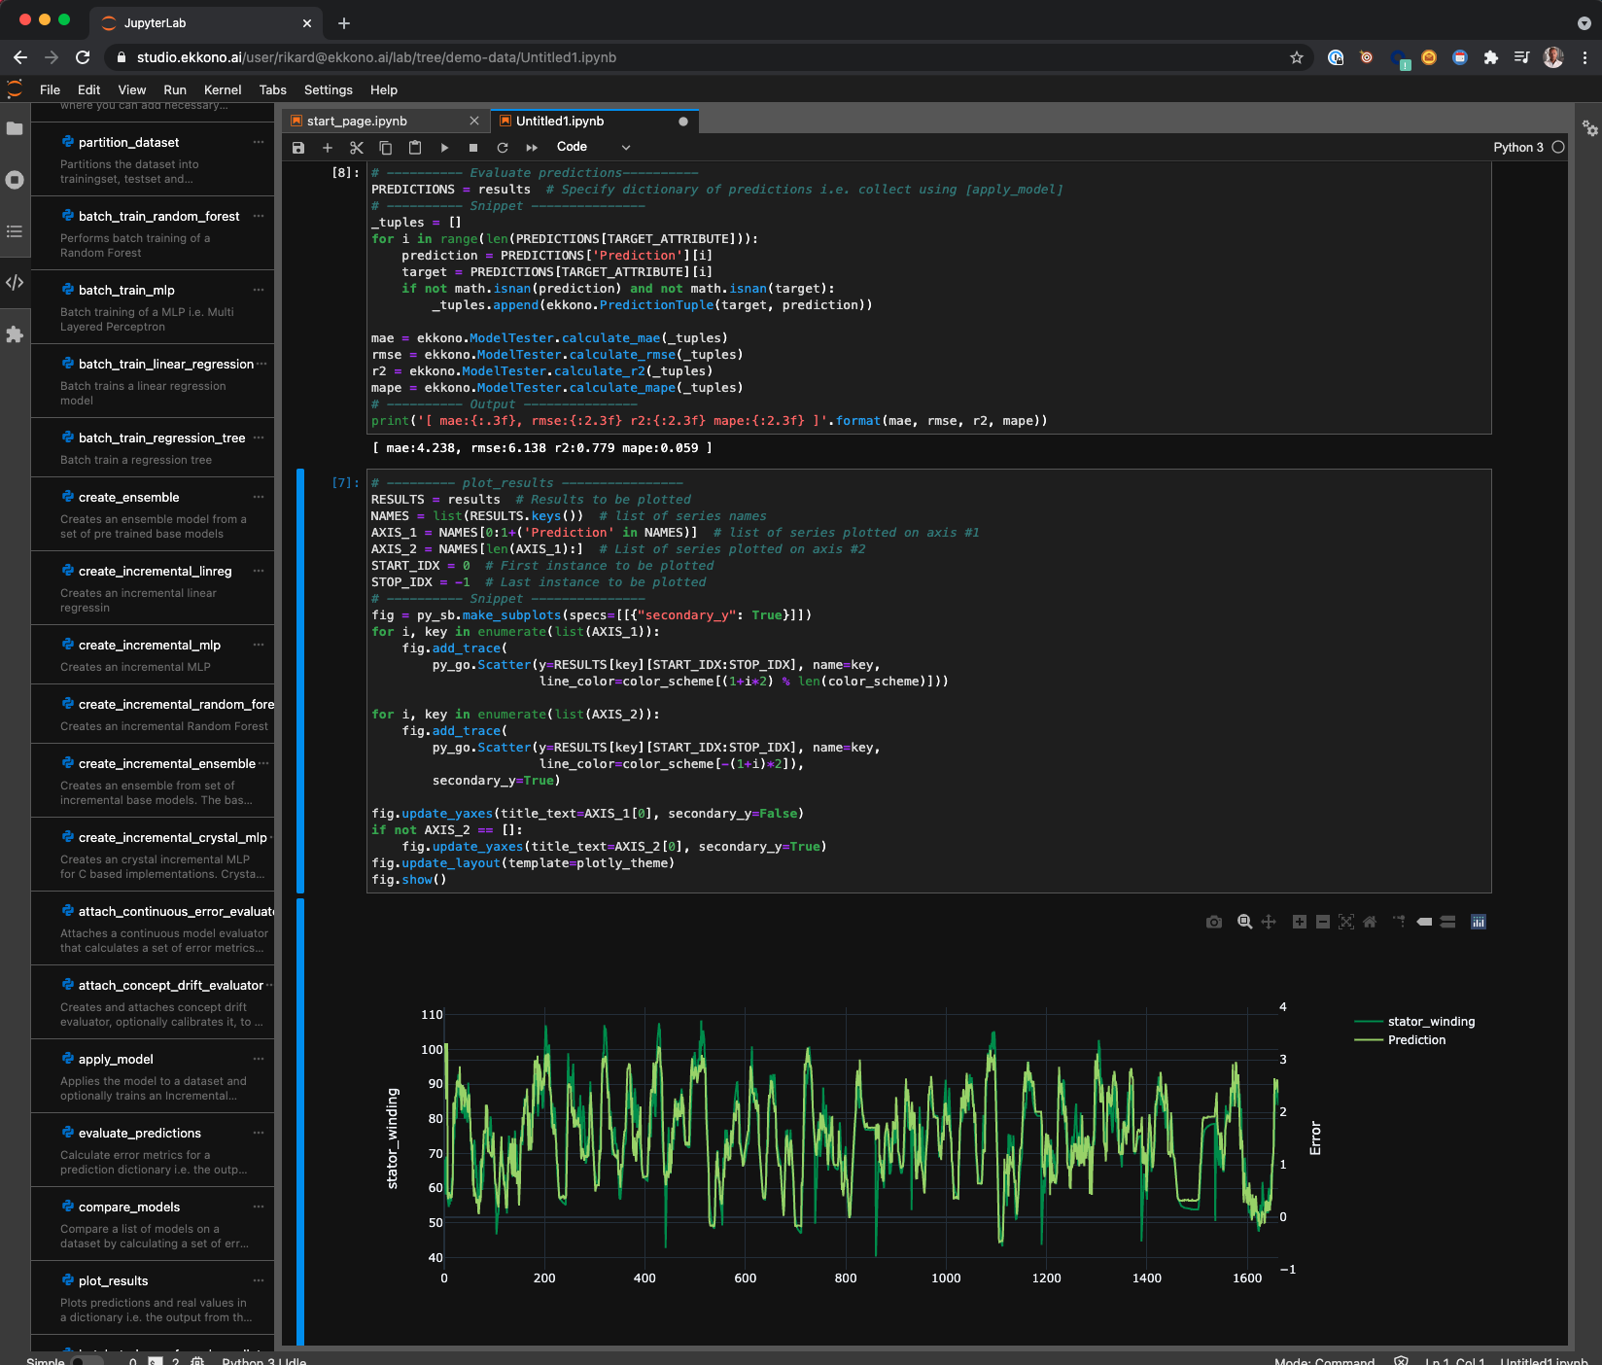
Product Offering
Ekkono SDK
A library for Edge ML, compiled to the target platform
Edge - Training and inference, Req. C++14 compatible compiler
Crystal - Subset of Edge features (Req. C99)
Primer - AutoML, Feature selection and Data Wrangling
(C++14, normally not run on the edge devices)
Extensive tutorials and documentation
Ekkono Studio
Cloud hosted ML workbench for running Edge, Crystal, Primer
Create solutions with drag and drop code Snippets
Evaluation, Feature Selection, Auto ML, plotting etc.
Export models to a binary format to load them from C++
Ekkono Studio

Slide 12


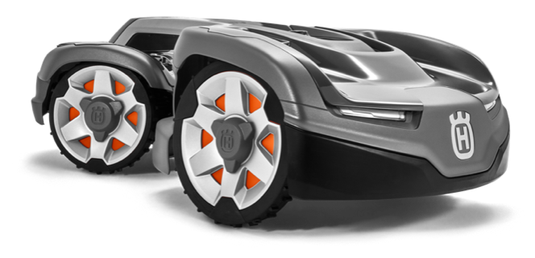


How it Works
Product with Sensors
Edge Machine Learning
Predictive, Self-Configuring
and Context-Aware

Slide 13
Ekkono’s Uniqueness
Added Smartness
University Research
Self-Learning Devices
Smart & Sustainable
Ekkono means cognition, and that is what we add to IoT. We make connected things smart by embedding advanced edge machine learning – that runs onboard the connected device. This empowers IoT to realize its true potential, where companies save and make money through predictive maintenance, automation, performance optimization, self-configuration, intuitive products, and new data-driven business models.
The result of seven years of research at the University of Borås, Sweden. A lightweight machine learning engine that can run on small hardware platforms, close to the data source, i.e. the sensors, on the device, where it can see and process all data, in real-time, and take instant actions. This reduces network load, make things less dependent
on connectivity and improves data integrity.
This enables individual learning per device. A vehicle learns the climate and traffic in which it operates, a machine learns its surroundings, and a robot mower learns your specific garden. This opens up for a lot of new features, and it makes Ekkono’s edge machine learning a powerful complement to your cloud solution, as it feeds good, enriched, individualized and relevant data.
IoT holds the promise of everything becoming smart – machines, vehicles, cities and devices. Reality is that most of them are still just connected. Smartness is capped at uploading raw data to a big-data haystack and showing historical averages for the entire installed base. With Ekkono you can deliver on IoT’s promise of making things genuinely smart.

Slide 14






Use Case Examples
Value created when using Ekkono’s software
Typical use cases enabled by Ekkono
Sensor virtualization
  Cost saving on sensors that are expensive or difficult to install.
Condition monitoring
  Cost savings on scheduled check-ups and spot checking.
Predictive alarming
  Predict failures ahead of time.
Predictive maintenance
  Cost savings on time spent compared to other types of maintenance, e.g. calendar-based maintenance.
  Maximizing the useful life of components and equipment.
  Less unplanned stops.
Device modeling
  Create your digital twin of device or component.
  Summarization of device use patterns.
Predictive control
  Cost saving through better utilization of resources.
  Customer retainment through the transferable and personalized configurations.
  Performance optimization and autotuning.

Slide 15
Ekkono and Qt
Data Driven Decision Support Systems requires accurate models and user inteintuitiverfaces
to be trusted and accepted by users and this is what Ekkono and Qt bring to the fingertips
of embedded developers in an accessible format.

Slide 16
Ekkono & Qt Use Cases
Data Driven Decision Support Systems requires accurate models and intuitive user interfaces to be trusted and accepted by users and this is the sweet spot for combining Ekkono & Qt.
Machine learning models can be created, tested and validated in Ekkono Studio and then loaded, hooked up to sensor and the user interface in Qt Design Studio.
All but the four use cases in the two top levels of the stair to the right are related to decision support and could be managed within Qt Design Studio.
More complex use cases can be done by adding additional C++ logic in the backend.

Slide 17
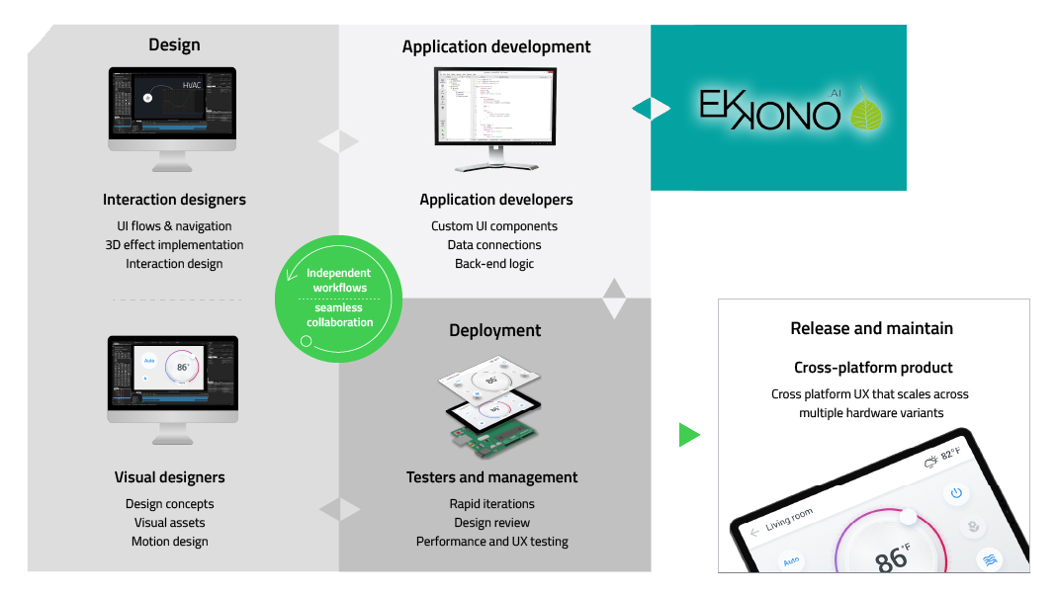
Integrating ML into Qt workflows

Slide 18



Software Architecture
Ekkono’s library sits in the back end – processing sensor data, training and running machine learning models. Before deployment, the models are created, validated and tested in Ekkono Studio.
Qt’s framework facilitates creation of the embedded application leveraging Ekkono – Qt Design Studio enables creation of intuitive user interfaces and connecting it the model which in turn can be hooked up to sensors. Through Qt Add-on libraries sensors and remote devices is also easily be easily handled.
Back end
Front end
Ekkono Studio

Slide 19
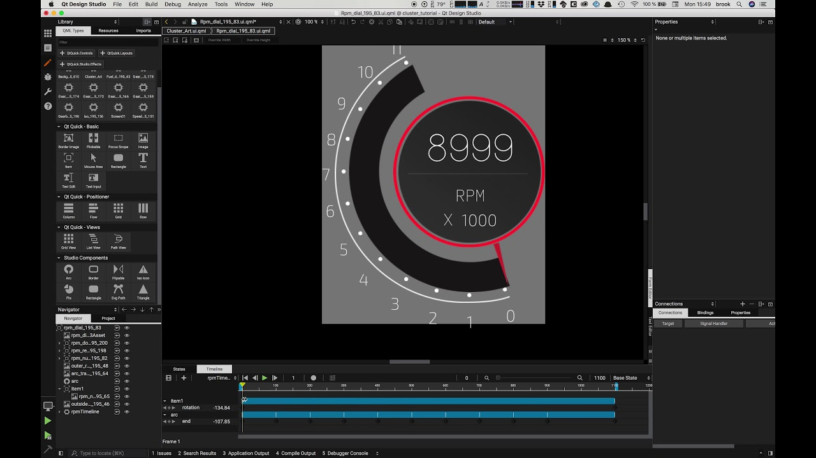
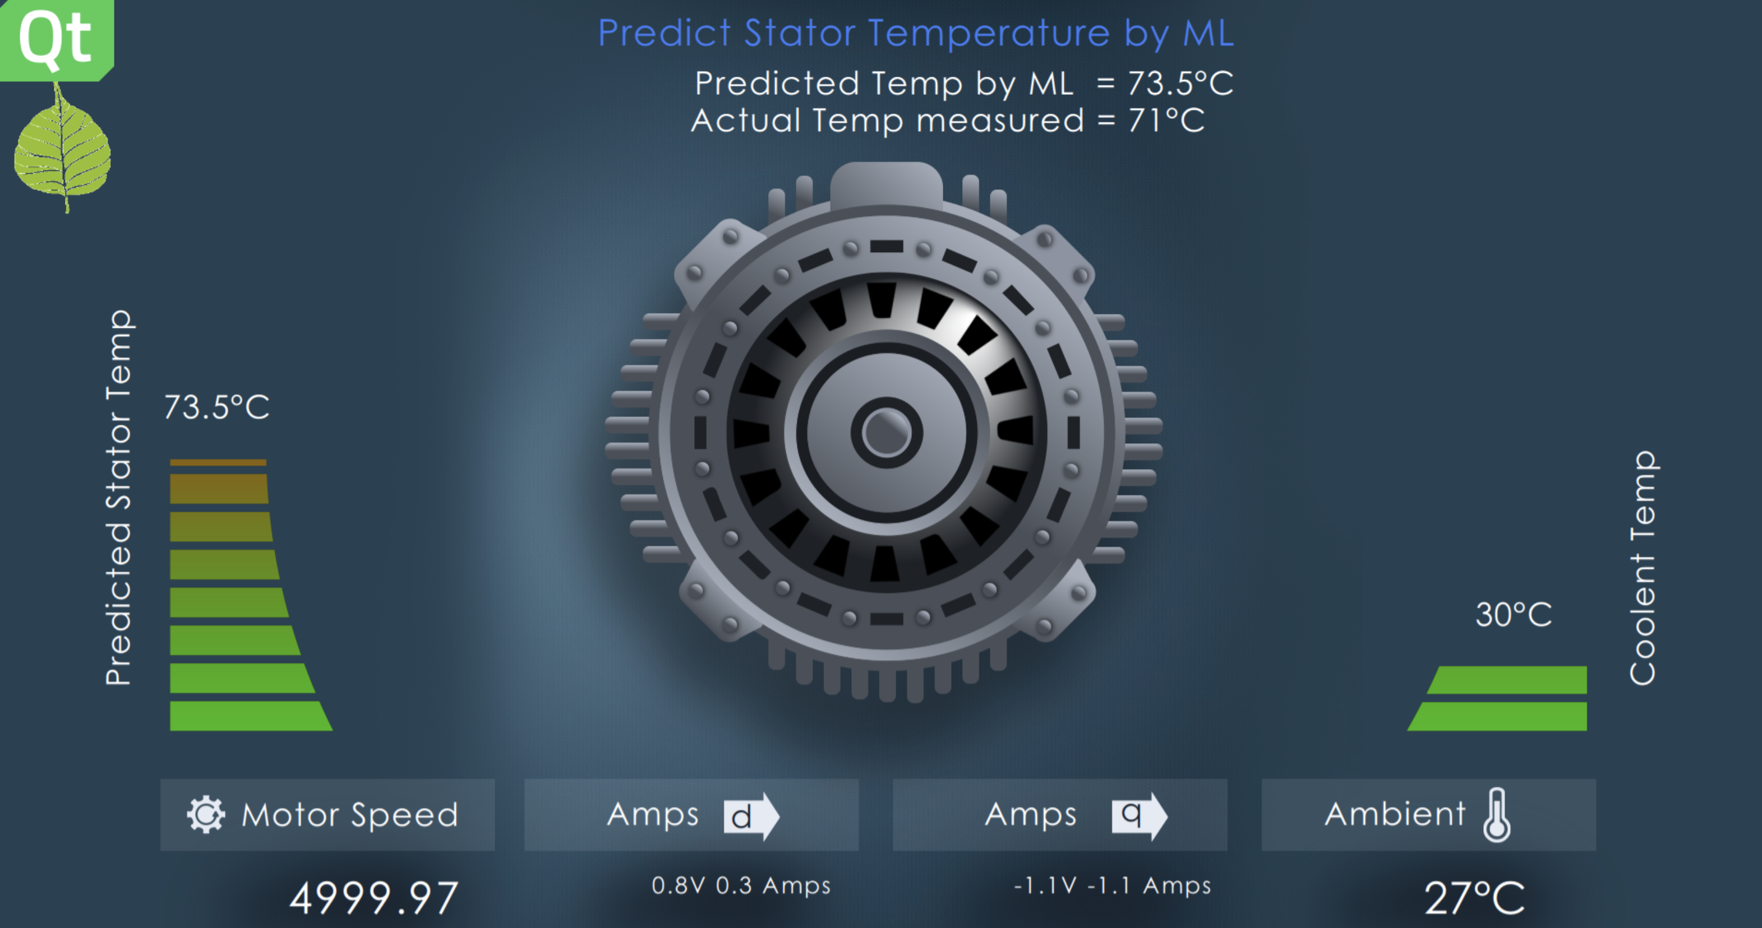
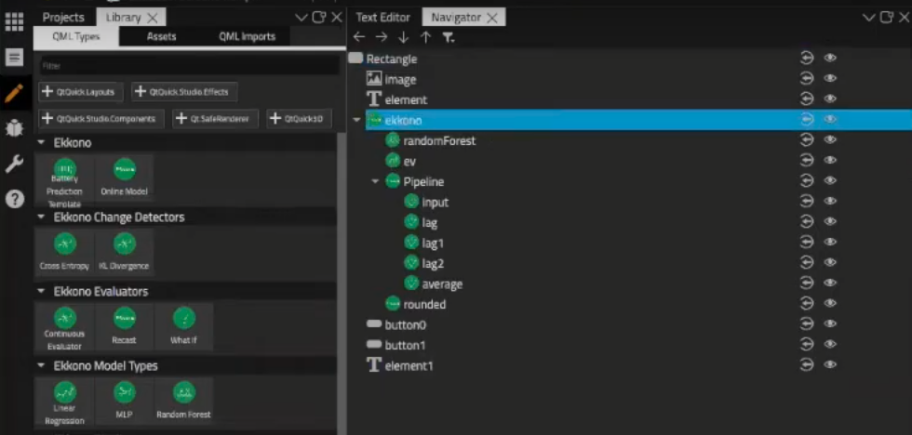
Design Studio Integration
Qt has a plug-in that allows you to load Ekkono models into Qt Design Studio.
The models can be hooked up to sensors in the graphical interface. Ekkono also supports incremental training of models instead of just model inference. This applies to both supervised learning regression models as well as unsupervised
on device learning models.
Supported Ekkono Models
Linear regression
Multilayer perceptron
Random forest
Decision trees
Ekkono change detector*
Ekkono anomaly detector*
*unsupervised learning algorithms

Slide 20
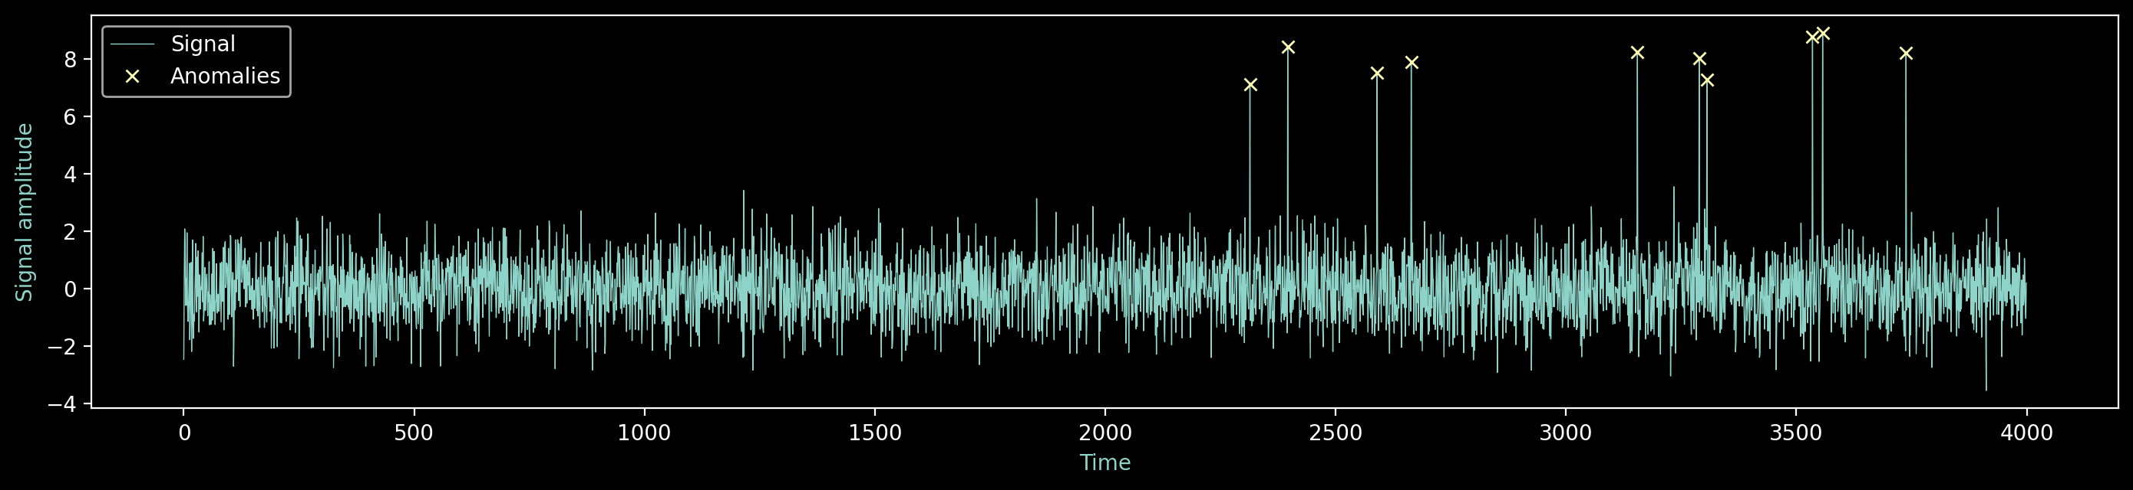
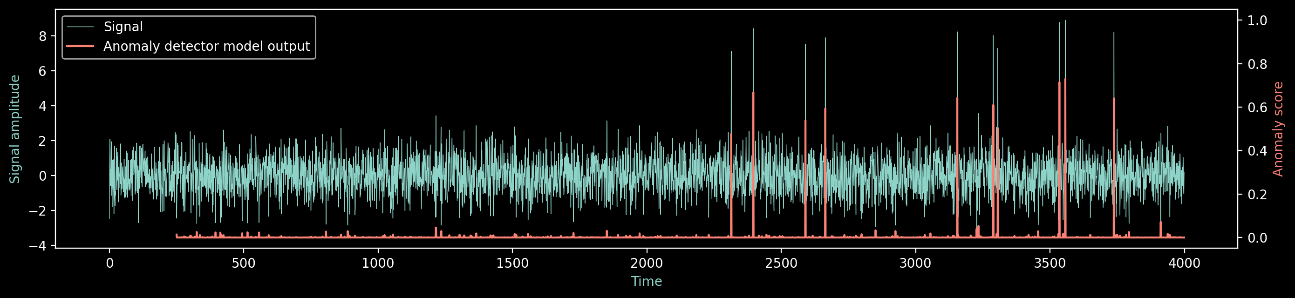
Use Case Example
Anomaly Detection
Ekkono has an algorithm for multivariate anomaly detection. It calibrates on a given window size and then starts reporting an anomaly score between 0 (nothing anomalous) and 1 (very anomalous).
model = edge.ModelFactory.create_anomaly_detector(data_pipeline_template, calibration_window_size = 250)
Each time the sensors are read from
anomaly_score = model.score(instance) #calibration is done automatically with the score-call
Calibration on first 250 observations

Slide 21
Why Ekkono + Qt?
If you are already working with Ekkono
Qt can provide the platform that is ready to catch the output from a solution with Ekkono. It can visualize it, feed it back into the system as a parameter, or communicate as a connected service.
If you are already working with Qt
If you are already using Qt and are looking to enable machine learning capabilities on your platform then consider the collaboration with Ekkono. You can scale down to microcontrollers. With a single add-on you can communicate with the state-of-the-art edge machine learning library. On top of it you can build applications that add smart features to your product. Qt + Ekkono reduces the number of steps involved and allows you to iterate on concepts faster.
If you are working with neither
Ekkono and Qt offer the smoothest machine learning to front-end integration on the market. Seamless deployment with little effort. Ekkono is built to be embedded and has no external dependencies, Qt provides the full eco system that fully supports interactions with Ekkono.

Slide 22
www.ekkono.ai | info@ekkono.ai

Slide 23


Design Studio Value proposition
Traditional UI development workflow
Design
Development
Deployment
UI specification
Product implementation
Deploy and test
Notes:
Hello again,
First, I would like to discuss the usual design development workflow.
It's not the designer who builds the design - it's the developer
Designer shares graphic assets and images - as photo or background
The job of the designer is to communicate the specs, screen and animation to give a more precise idea of what is needed
But the developer builds the user interface from scratch by checking the graphical assets provided by the designer.
Until development is not finished output of application on the final device is not know. Validation of design is done at very later stage…
Each new change in design will add workload on the developers….
Late validation of design in development cycle, responsibility of design validation is shifted to developers are real issues ….

Slide 24



Design Studio Value proposition
Designer & Developer tools
Design
Development
Deployment
Notes:
These issues are due to limitation of tools
Because tools are not common between designer and developers.
Except some assets, the developer can’t reuse the work of the designer
Much of this design works goes the trash
It's a very big waste of time
This makes it more difficult to achieve satisfactory graphics quality
It is a source of tension between the Design and development teams

Slide 25
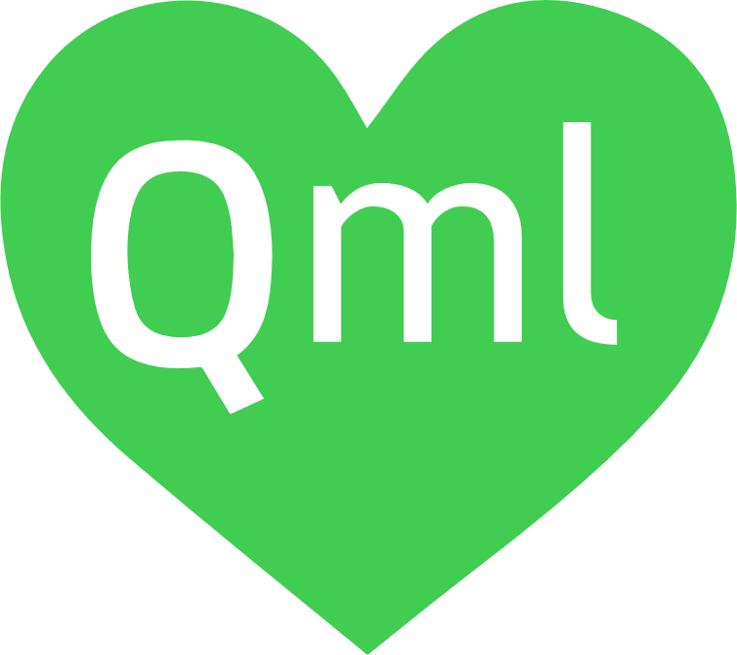


Design Studio Value proposition
Enhanced UI development workflow
Design
Development
Deployment
Prototype
on real device
Deploy and test
Notes:
Qt is already solving these pain points by the enhanced UI development work flow.
1 - QT creates a QT bridge on the four main design tools: Photoshop, Figna, Sketch (IOS) and soon Xd - These Bridges allow to export the work of the Designer on DS
2 – Import is "pixel perfect" –And DS allows now designer to add a large proposal of effects and animation
3 The difference between us and other tools is imports and animation are interpreted in QML language - it is a descriptive language both usable by the designer and the developer
4 - No need to wait for the full deployment of the application on the device - the preview allows the designer to verify and validate
Once we enabled the designer developer to work in enhanced UI workflow. We realized there are more to do in this workflow.
One part we were exploring with our partner Ekkno is how to bring machine learning modules and integrate machine learning in UI development flow.

Slide 26
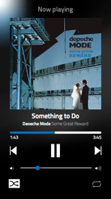


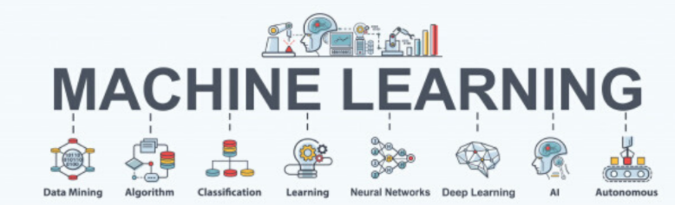




Design Studio Value proposition
Enhanced UI development with ML workflow
Design
Interaction Designer
Developer
ML Modeling
Deploy and test
Prototype
on real device
Machine learning Engineer
Notes:
Thanks for Ekkono integration in Qt Design studio and Qt creator now both designer and developer can also work in the machine learning modules.
Goal is to easy the integration of a machine learning module, which is created by the ekkon studio. Machine learning engineer works on the Ekkano studio and generated the target machine learning module.
That module can then easily integrate UI application, connect input and out to the module.. Is done in design studio by dragging and dropping as any other graphical widget.
Once input and oputput connection are made, DS enable interaction engineers to test the UI with machine learning module. Once test on UI and machine learning modules are done project can be passed to developers.
Developer can connect the machine learning module now to the real sensors data and deploy the I with machine learning module.

Slide 27

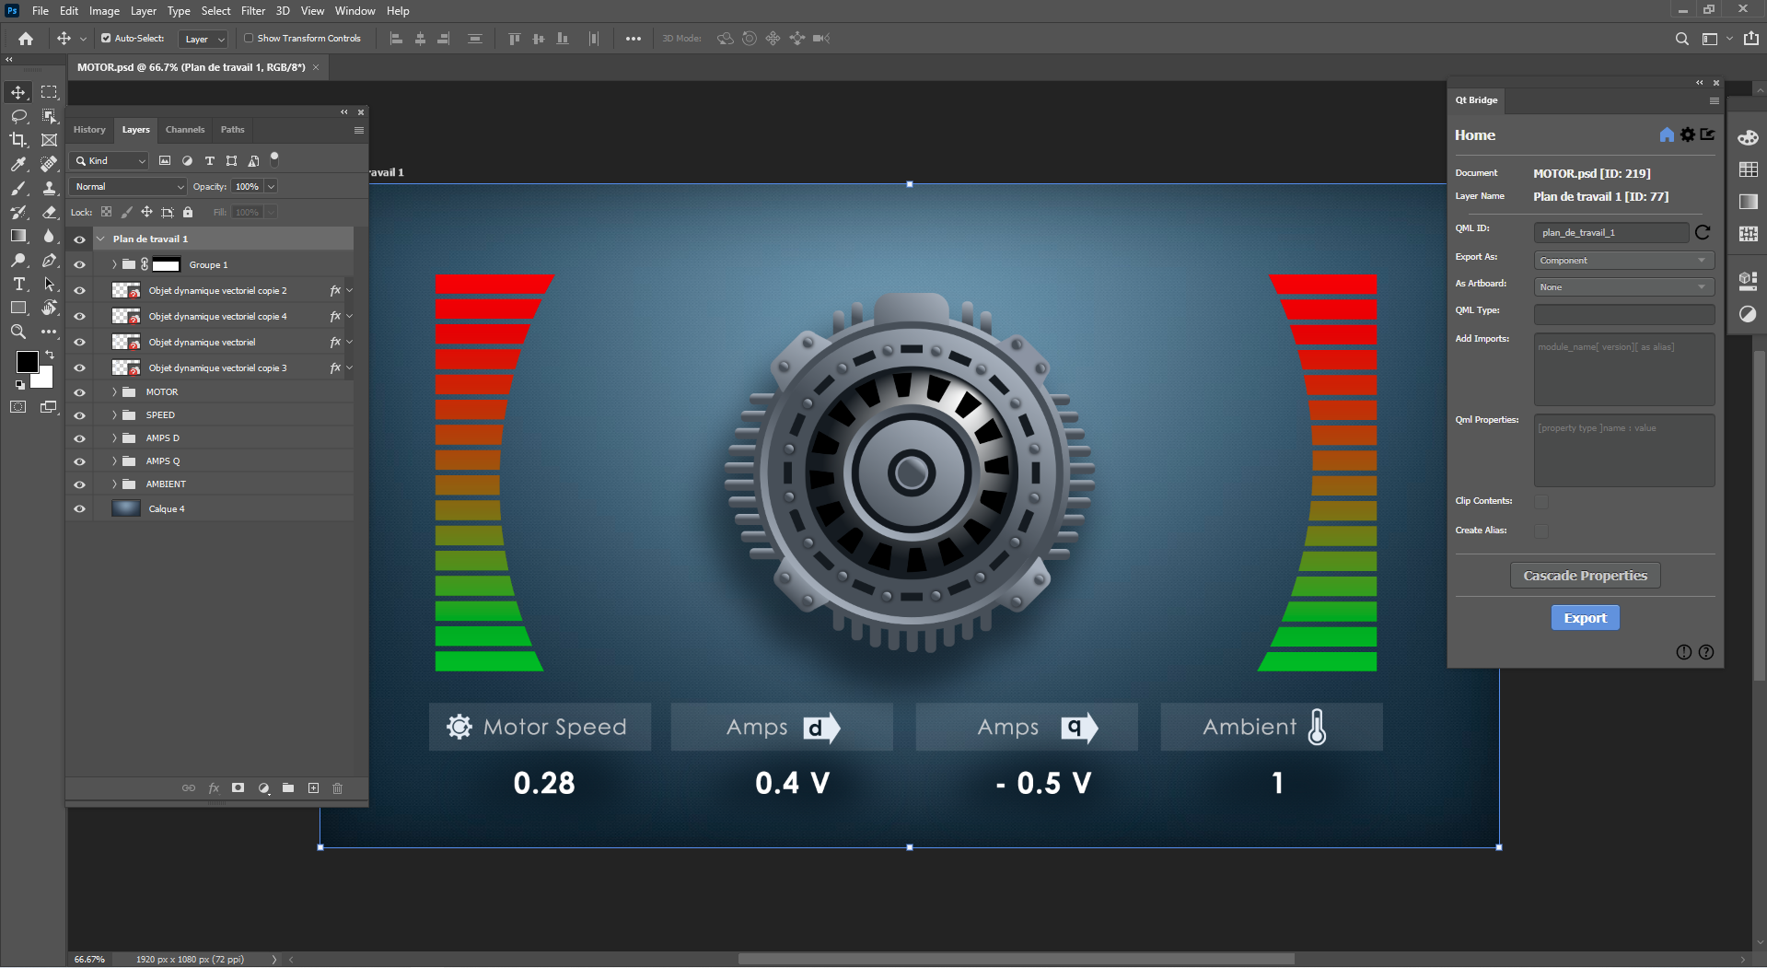
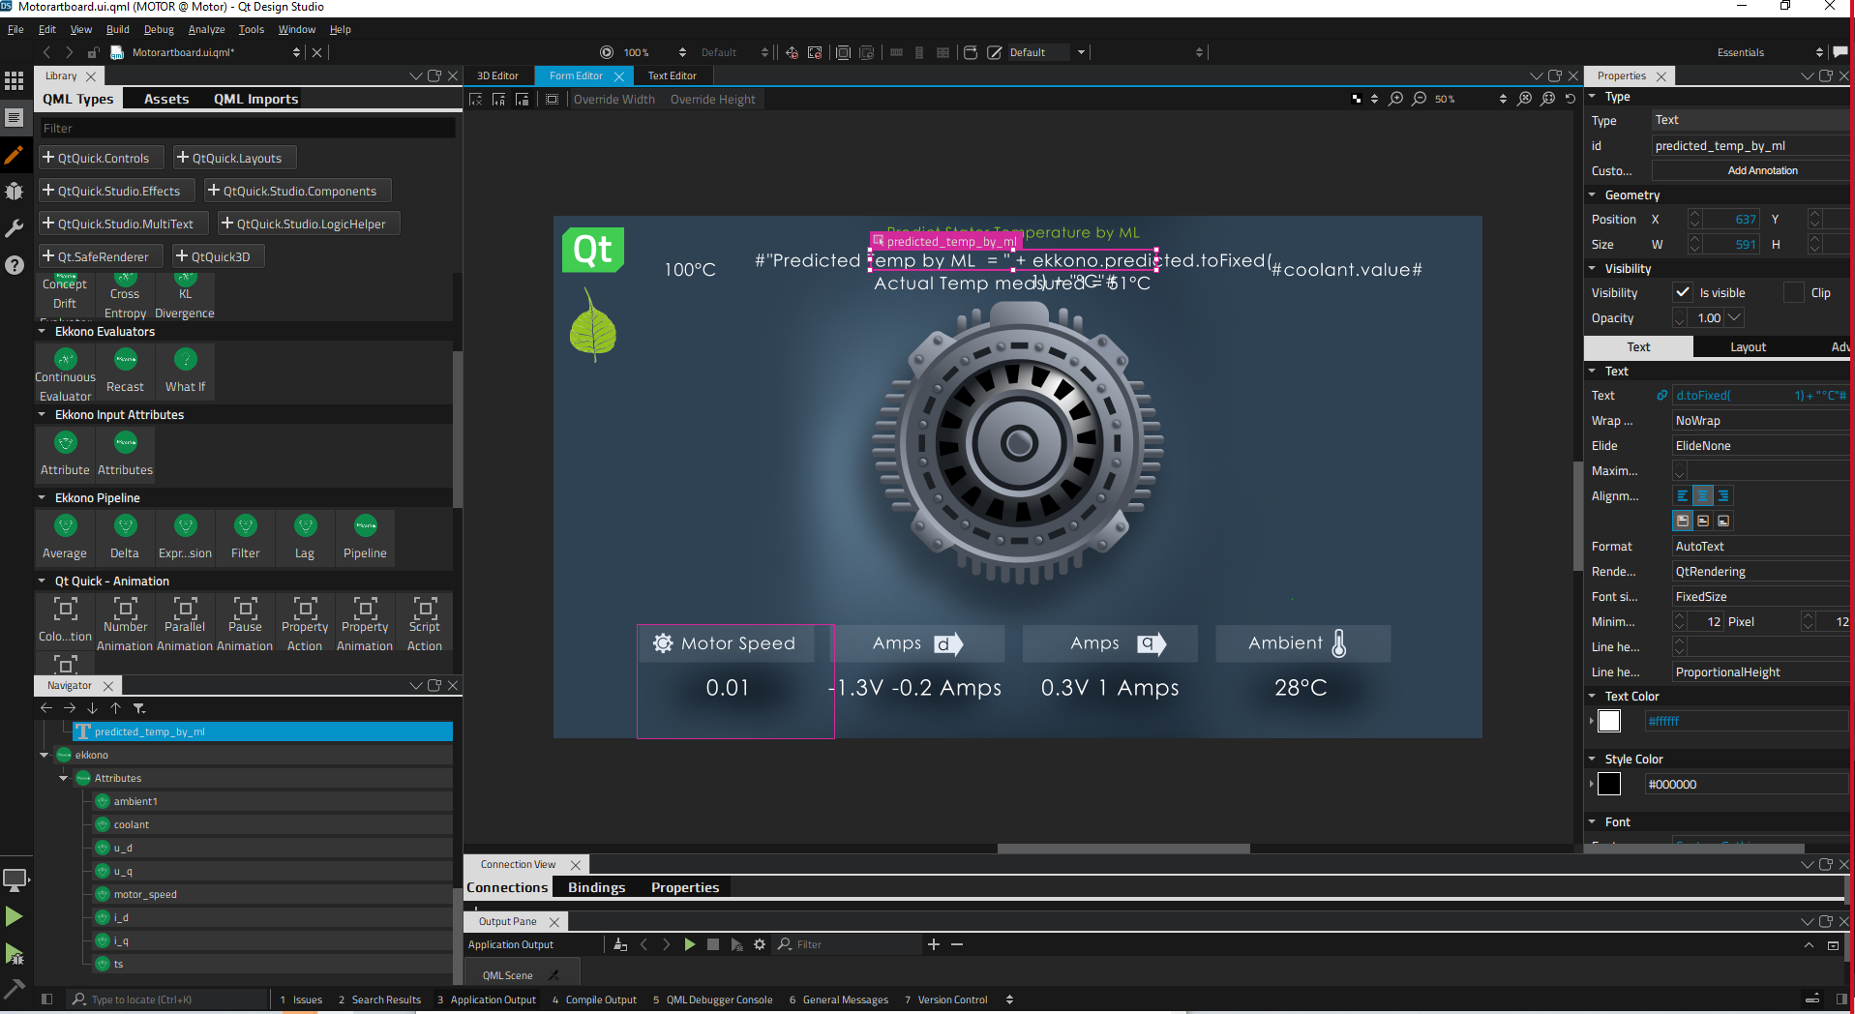
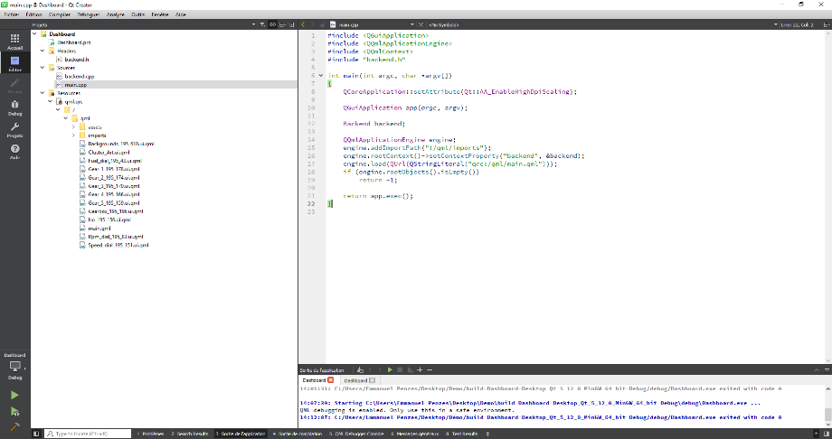
Design Studio Value proposition
Qt designer – ML - Developer demonstration
UI Design
ML Modeling
UI Prototyping +
ML integration
Project Development
Notes:
I will present an application : UI design and machine learing algorithm integration.
I will use a photoshop artwork for UI design, that artwrok will be imported to Qt deisgn studio for UI deisgn creation.
I will use the electrical motor module generated by my dear collague Simon in Qt Design studio.
I will quickly show a simpile animation, rotation of rotator.
Then I will show how can we make integration of electrial moter module generated by the simon. I have some dummy data file, I will use dummy data file for the input of the machine learning and display the predicated value.
I will first run my project UI + machine learing on the Windows PC and finally I will also run the same project on the Rpi for the prototyping purpose.

Slide 28

How to try Qt & Ekkono in your commercial application
Booking an appointment with us
Available for commercial trials or commercial customers only
Reaching out your local Qt contact
Reaching out your local Ekkono contact
New to Qt? Write to us: https://www.qt.io/contact-us/sales-contact-request

Slide 29
Q&A
The future is written with Qt
www.qt.io

